Slide 1
Title: Sales Report Analysis (Q4 2024 – Q3 2025)
Overview of trends, top products, and customer insights

Slide 2
INTRODUCTION:
Sales report analysis covering Q4 2024 – Q3 2025
The goal of this project was to examine sales trends, identify top-performing products and understand customer behavior.
I used a sample sales dataset to simulate real business data, which analyzed using SQL and Excel to build a dashboard that visualizes key insights for decision making.
OBJECTIVES
Identify highest revenue product categories
Track monthly and quarterly sales trends
Highlight top customers and top products
Examine order status and returns

Slide 3
Quarterly Performance Trend (Q3 2025 vs Q4 2024)
Q3 2025 results show a positive performance trend compared to Q4 2024, with revenue up 17%, quantity up 7%, and unit price up 12%.
This is not a direct YOY comparison, it provides an early signal of continued growth heading into Q4 2025.

Slide 4
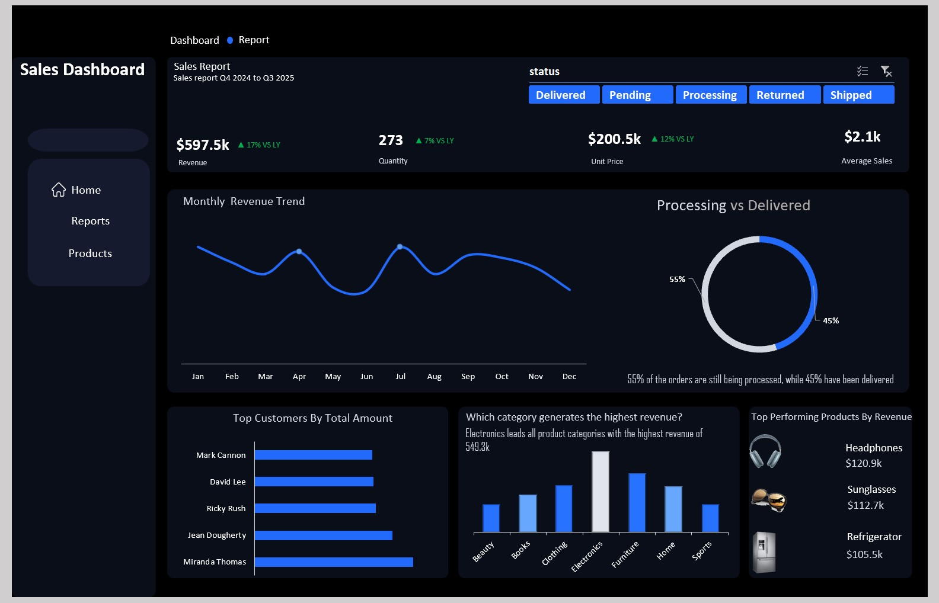

Slide 5
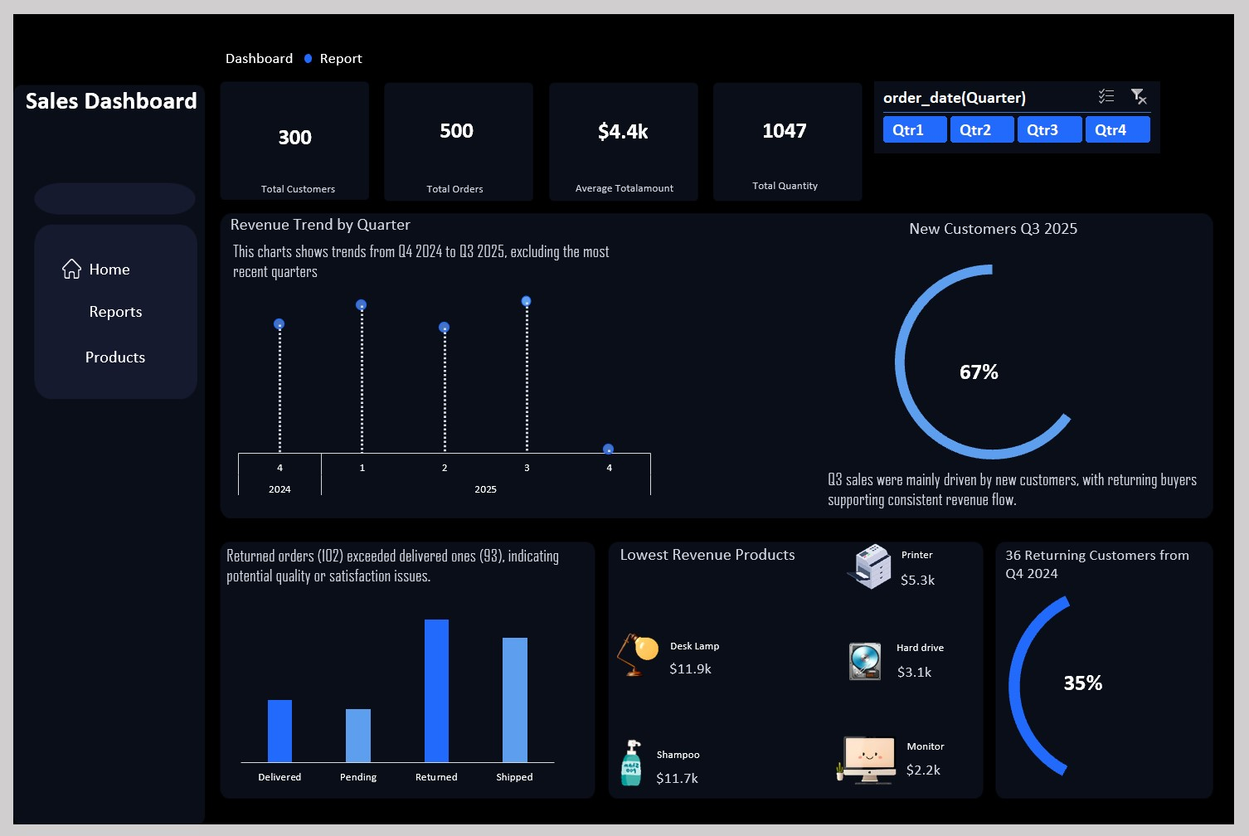

Slide 6
Monthly Sales Trend
Sales increased from January, but dropped in March, May, June, August, and December. The biggest drop was in May and June
Quarterly Revenue Trend
Sales were recorded from Q4 2024 to Q3 2025, not including Q4 2025.
Q4 2024: Strong start.
Q2 2025: Slight drop.
Q3 2025: Strong recovery and growth.

Slide 7
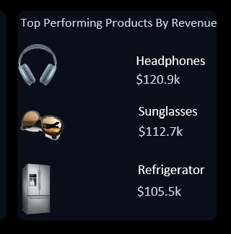
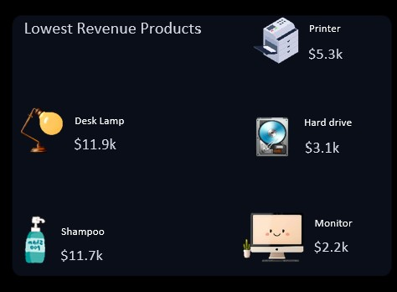
Top Performing products by Revenue
Headphones – 120.9k
Sunglasses – 112.7k
Refrigerator – 105.5k
Lowest Revenue Products
Monitor – Lowest revenue
Hard drive – Lowest revenue
Note: This products made the least revenue

Slide 8
Summary Insights
Electronics category is top revenue contributor
Headphones are the highest-selling product
Returned orders need attention
Top customers are key revenue drivers
Sales are generally growing with some monthly dips
Recommendations
Investigate reasons for returns
Promote top products
Focus on improving low-performing products
Reward top customers to retain loyalty
Monitor trends to plan better

